Slide 1



Lightweight Hardware Transactional Memory Profiling
Qingsen Wang, Pengfei Su, Xu Liu
Milind Chabbi
College of William & Mary
Scalable Machines Research

Slide 2
Synchronization in Parallelism
Pessimistic Concurrency Control
Lock
Optimistic Concurrency Control
Transactional Memory (TM)
lock()
unlock()
T1
T2
lock()
wait()
unlock()
Software Transactional Memory (STM)
Hardware Transactional Memory (HTM)
TM_begin()
TM_end()
T1
TM_begin()
TM_end()
T2
abort
TM_begin()
retry
TM_end()
T3

Slide 3
Hardware Transactional Memory
Working principle
Abort reason
Conflict abort
Capacity abort
Synchronous abort
Abort
Restore the snapshot
Y
Save a snapshot of current state
Store any change in cache (invisible to others)
Any concurrency requirement violated?
N
Make changes visible to others
Commit
Threads contend for the same cache line
Accessed memory > hardware supported max size
System calls, special instructions, etc.

Slide 4
Hardware Transactional Memory
Workflow
Critical section
Wait for lock to be free
Start
Y
Retry?
LOCK();
// user code
UNLOCK();
TM_BEGIN;
// user code
TM_END;
Acquire the lock
Begin HTM
N
N
Succeed?
User code
User code
Fallback path
HTM path
End HTM
Y
Release the lock
Finish

Slide 5
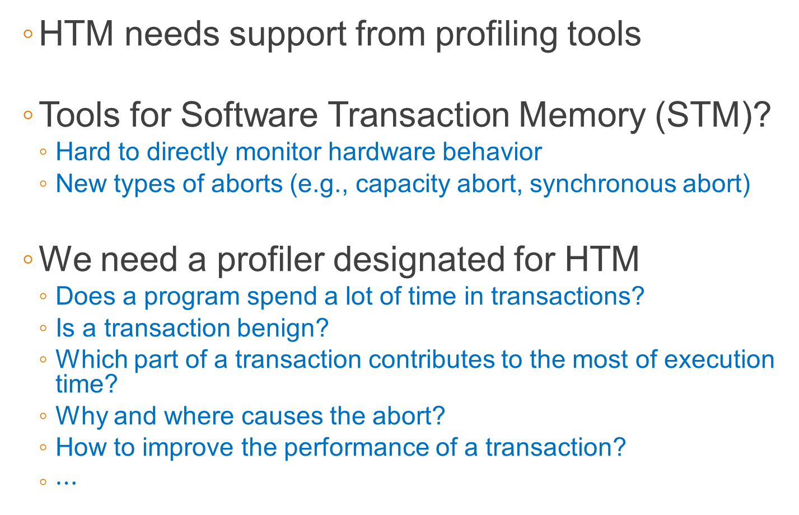
Hardware Transactional Memory
HTM needs support from profiling tools
Tools for Software Transaction Memory (STM)?
Hard to directly monitor hardware behavior
New types of aborts (e.g., capacity abort, synchronous abort)
We need a profiler designated for HTM
Does a program spend a lot of time in transactions?
Is a transaction benign?
Which part of a transaction contributes to the most of execution time?
Why and where causes the abort?
How to improve the performance of a transaction?
$⋯$

Slide 6
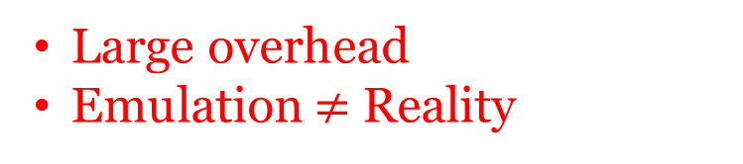
Existing Work
TSXProf
Record HTM execution timestamps from instrumentation
Replay in software for contention analysis
Perf, VTune
PMU sampling
Record HTM status from hardware hint (e.g., conflict abort? capacity abort?)
Large overhead
Emulation $≠$ Reality
Not enough information for analysis

Slide 7
Solution – TxSampler
Lightweight
~4%(time)
<5MB/thread (memory)
Insightful
Time decomposition
Abort analysis
Contention Identifying

Slide 8
TxSampler – How it works
Sample from hardware events
Resolve callstack
Attribute metric

Slide 9
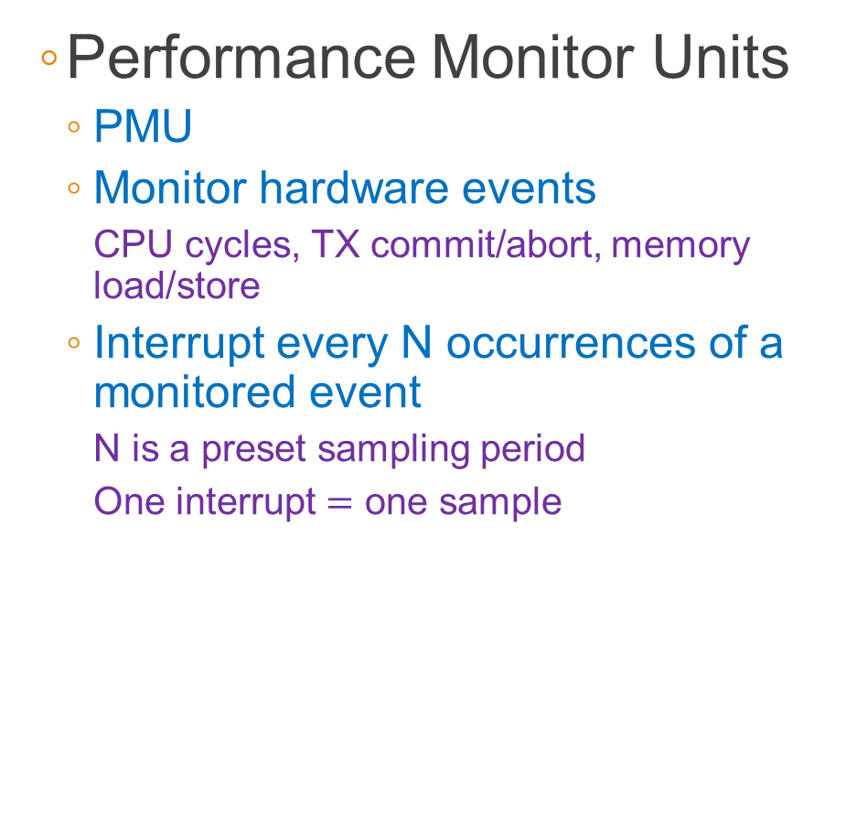
TxSampler – How it works
Performance Monitor Units
PMU
Monitor hardware events
CPU cycles, TX commit/abort, memory load/store
Interrupt every N occurrences of a monitored event
N is a preset sampling period
One interrupt $=$ one sample
Sample from hardware events
Resolve callstack
Attribute metric

Slide 10
Solution – TxSampler
Sample from hardware events
Resolve callstack
Attribute metric
Callstack unwinding

Slide 11
Solution – TxSampler
Increment corresponding metrics under current callstack
Statistical attribution, NOT for individual transactions
Sample from hardware events
Resolve callstack
Attribute metric

Slide 12
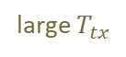



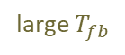
Novice Guide
Time Analysis
Metrics to investigate
High TX overhead
Merge small transactions
large $T_{oh}$
No HTM-related issues
START
Elide read lock
Use fine-grained locks to serialize
no
High lock waiting
large $T_{tx}$
CS is long?
yes
Analyze time decomposition
Redesign algorithm
Shrink transactions
Split transactions
Shared data contention
large $T_{fb}$
Symptoms
large $T_{wait}$
yes
Relocate data to different cache lines
Relocate data based on threads.
Conflicts caused by shared data
False sharing
no
Find a place (function, transaction, loop, line, etc.) with largest abort/commit, abort number, abort weight, $T_{fb}$, $T_{wait}$, etc.
high conflict aborts
Redesign algorithm
Split transactions
Shrink transactions
Relocate data to share cache lines
Analyze abort type
Optimization suggestion
Footprint large
high capacity aborts
high sync aborts
Move unfriendly instructions/call out from transaction
Use a friendly equivalent
Abort Analysis
Unfriendly instructions/call inside transaction

Slide 13
Challenge I – Callstack inside HTM
How sampling works
suspend
PMU Sample
Retrieve callstack here
Attribute metrics
resume
profiler routine
main program

Slide 14
Challenge I – Callstack inside HTM
How sampling works
TM_BEGIN
Trustworthy?
PMU Sample B
PMU Sample A
suspend
Retrieve callstack here
Attribute metrics
resume
fallback path
HTM path
profiler routine
TM_END
main program

Slide 15
Challenge I – Callstack inside HTM
Last Branch Records (LBRs)
Record most recently executed branches
Each entry contains
“from” address
“to” address
flags of execution states

Slide 16
Challenge I – Callstack inside HTM
Reconstruct callstack
PMU sample
main()→A()→B()
void A(){
TM_BEGIN;
B();
C();
TM_END;
}
int main(void){
A();
return 0;
}
void D(){
...
//POINT X
...
}
void C(){
D();
}
void B() {
D();
}
Call stack unwinding
Index | Content | Content | abort | abort | in-htm | in-tsx
0 | Call IR handler | Call IR handler | 1 | 1 | 0 | 0
1 | Call D | Call D | 0 | 0 | 1 | 1
2 | Call C | Call C | 0 | 0 | 1 | 1
3 | B return | B return | 0 | 0 | 1 | 1
4 | D return | D return | 0 | 0 | 1 | 1
5 | Call D | Call D | 0 | 0 | 1 | 1
6 | Call B | Call B | 0 | 0 | 1 | 1
... (related to TM setting) …
… | Call A |  |  | 0 |  | 0
Retrieve LBRs
main()→A()→C()->D()
C()->D()

Slide 17
Challenge II – Time Decomposition
inHTM
inFallback
inLockWaiting
inOverhead
Critical Section

Slide 18
Challenge II – Time Decomposition
inCS = inHTM + inFallback + inLockWaiting + inOverhead
Wait for lock to be free
Start
Y
Retry?
Acquire the lock
Begin HTM
N
N
User code
Succeed?
User code
End HTM
Y
Release the lock
Finish

Slide 19
Challenge II – Time Decomposition
inCS = inHTM + inFallback + inLockWaiting + inOverhead
Wait for lock to be free
Start
Y
Retry?
Acquire the lock
Begin HTM
N
N
User code
Succeed?
User code
End HTM
Y
Release the lock
Finish

Slide 20
Challenge II – Time Decomposition
inCS = inHTM + inFallback + inLockWaiting + inOverhead
Wait for lock to be free
Start
Y
Retry?
Acquire the lock
Begin HTM
N
N
User code
Succeed?
User code
End HTM
Y
Release the lock
Finish

Slide 21
Challenge II – Time Decomposition
inCS = inHTM + inFallback + inLockWaiting + inOverhead
Wait for lock to be free
Start
Y
Retry?
Acquire the lock
Begin HTM
N
N
User code
Succeed?
User code
End HTM
Y
Release the lock
Finish

Slide 22
Challenge II – Time Decomposition
inCS = inHTM + inFallback + inLockWaiting + inOverhead
Wait for lock to be free
Start
Y
Retry?
Acquire the lock
Begin HTM
N
N
User code
Succeed?
User code
End HTM
Y
Release the lock
Finish

Slide 23
Challenge II – Time Decomposition
inCS = inHTM + inFallback + inLockWaiting + inOverhead
Wait for lock to be free
Start
Y
Retry?
Acquire the lock
Begin HTM
N
N
User code
Succeed?
User code
End HTM
Y
Release the lock
Finish

Slide 24
Challenge II – Time Decomposition
HTM library adds thread-local status flags
Wait for lock to be free
Start
Y
inLockWaiting = true
Retry?
Acquire the lock
Begin HTM
N
N
inLockWaiting = false
Succeed?
User code
User code
End HTM
Y
Release the lock
Finish

Slide 25
Challenge II – Time Decomposition
Profiler routine queries the status flags to attribute the corresponding metric
if (inLockWaiting) {
cur_context.timeInLockWaiting++;
}

Slide 26
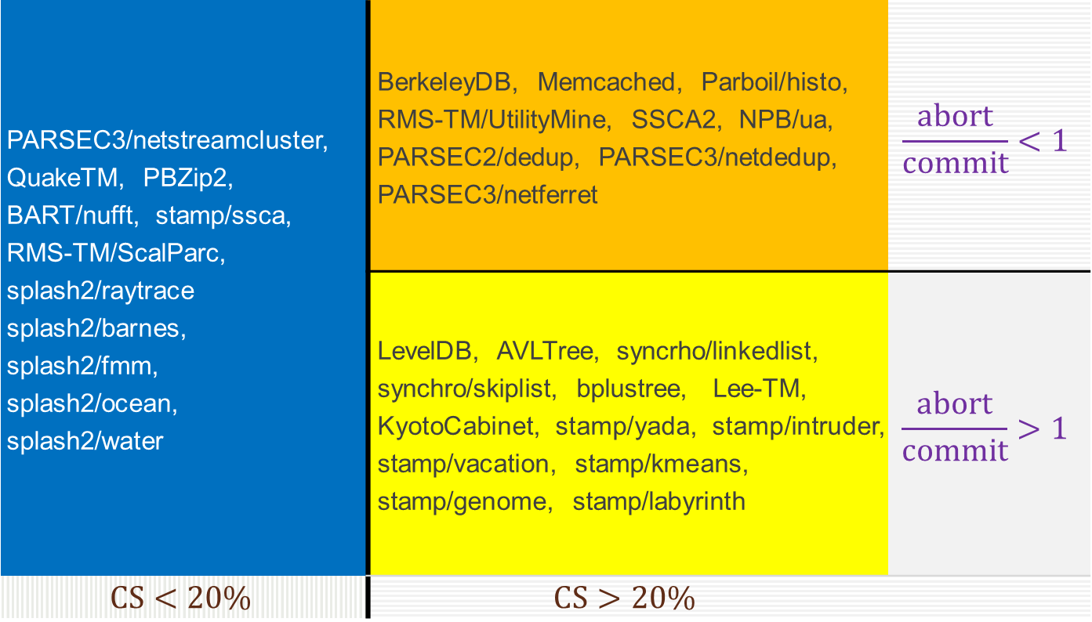
HTMBench
PARSEC3/netstreamcluster, QuakeTM, PBZip2, BART/nufft, stamp/ssca, RMS-TM/ScalParc, splash2/raytrace splash2/barnes, splash2/fmm, splash2/ocean, splash2/water | BerkeleyDB, Memcached, Parboil/histo, RMS-TM/UtilityMine, SSCA2, NPB/ua, PARSEC2/dedup, PARSEC3/netdedup, PARSEC3/netferret | $$\frac{abort}{commit}<1$$
 | LevelDB, AVLTree, syncrho/linkedlist, synchro/skiplist, bplustree, Lee-TM, KyotoCabinet, stamp/yada, stamp/intruder, stamp/vacation, stamp/kmeans, stamp/genome, stamp/labyrinth | $$\frac{abort}{commit}>1$$
$$CS<20\%$$ | $$CS>20\%$$
>30 benchmarks

Slide 27
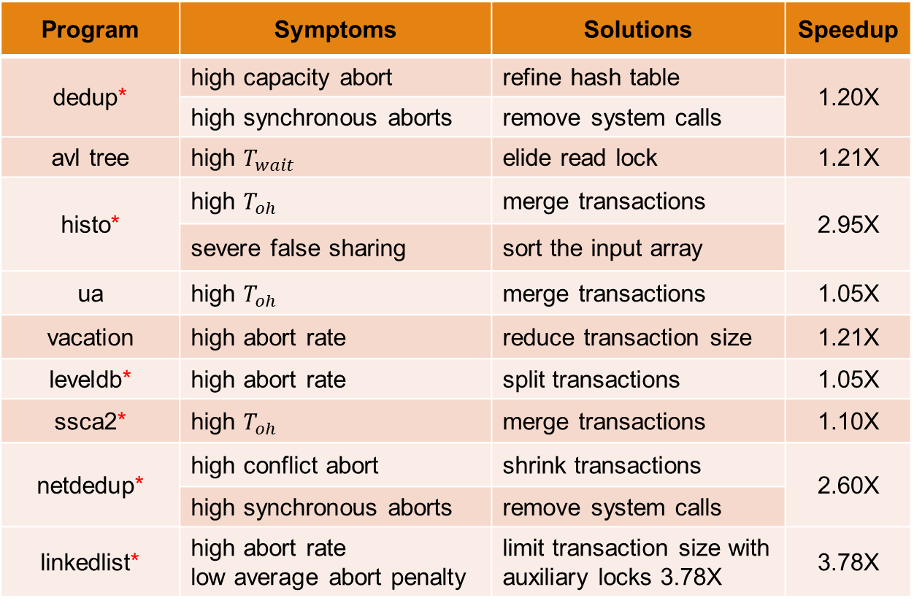
Optimization
* newly found
Program | Symptoms | Solutions | Speedup
dedup* | high capacity abort | refine hash table | 1.20X
 | high synchronous aborts | remove system calls
avl tree | high $T_{wait}$ | elide read lock | 1.21X
histo* | high $T_{oh}$ | merge transactions | 2.95X
 | severe false sharing | sort the input array
ua | high $T_{oh}$ | merge transactions | 1.05X
vacation | high abort rate | reduce transaction size | 1.21X
leveldb* | high abort rate | split transactions | 1.05X
ssca2* | high $T_{oh}$ | merge transactions | 1.10X
netdedup* | high conflict abort | shrink transactions | 2.60X
 | high synchronous aborts | remove system calls
linkedlist* | high abort rate low average abort penalty | limit transaction size with auxiliary locks 3.78X | 3.78X

Slide 28
Case Study – Dedup
Compresses data via deduplication
Consists of three major stages
ChunkProcess
FindAllAnchors
Compress
Runs with 4 threads per major stage

Slide 29
Case Study – Dedup
Time analysis

Slide 30
Case Study – Dedup
Abort analysis
High capacity aborts
High synchronous aborts

Slide 31
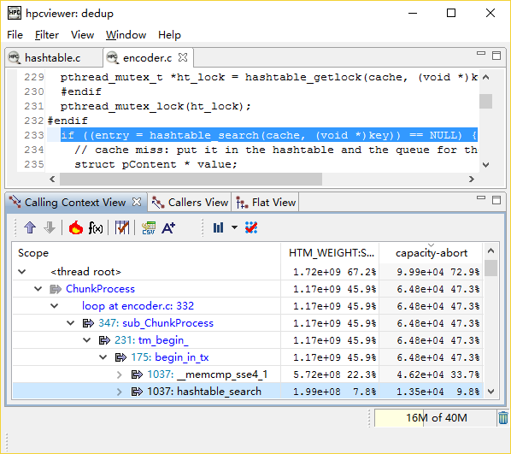
Case Study – Dedup
Abort analysis
High capacity aborts
High synchronous aborts
Abort weight
Capacity abort
Pseudo node
In HTM

Slide 32

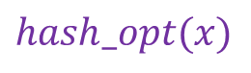

Case Study – Dedup
Abort analysis
High capacity aborts
High synchronous aborts
$$hash(x)$$
$$hash_opt(x)$$
X
X
Bin utilization: 2.2%
Bin utilization: 82%

Slide 33
Case Study – Dedup
Abort analysis
High capacity aborts
High synchronous aborts

Slide 34
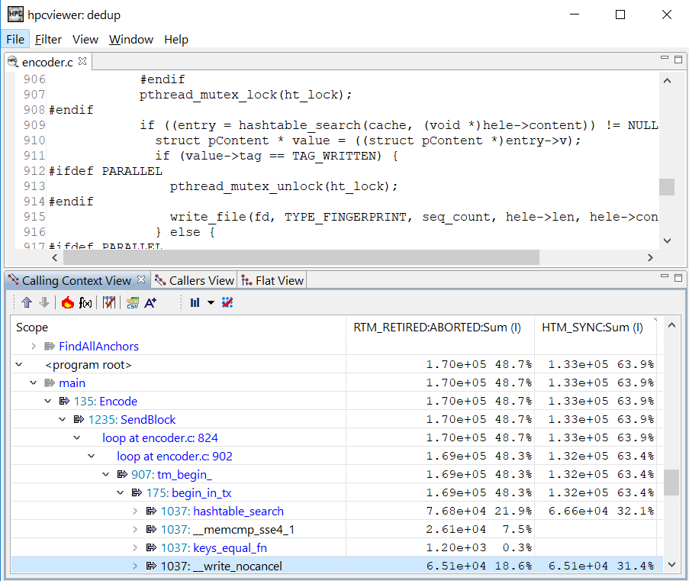
Case Study – Dedup
Abort analysis
High capacity aborts
High synchronous aborts

Slide 35
Case Study – Dedup
Optimization benefit
Capacity aborts: 97% ↘
Synchronous aborts: 26% ↘
Speedup: 1.20X

Slide 36
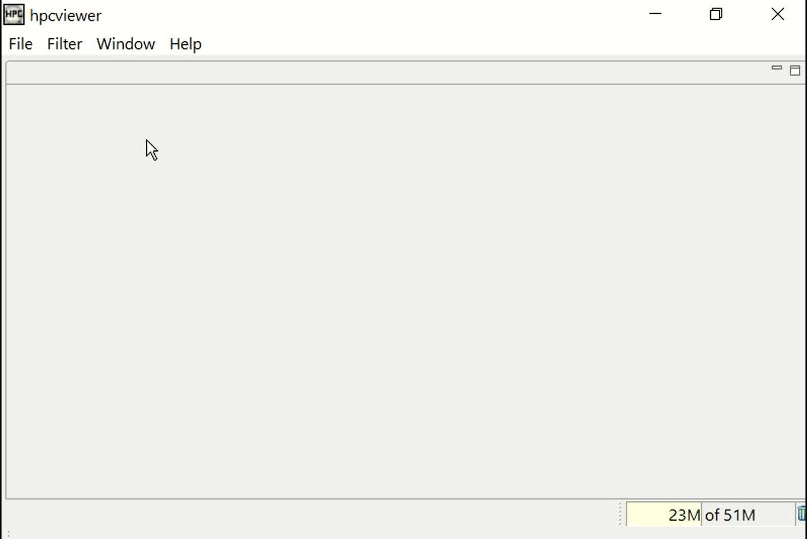
Case Study – Dedup

Slide 37
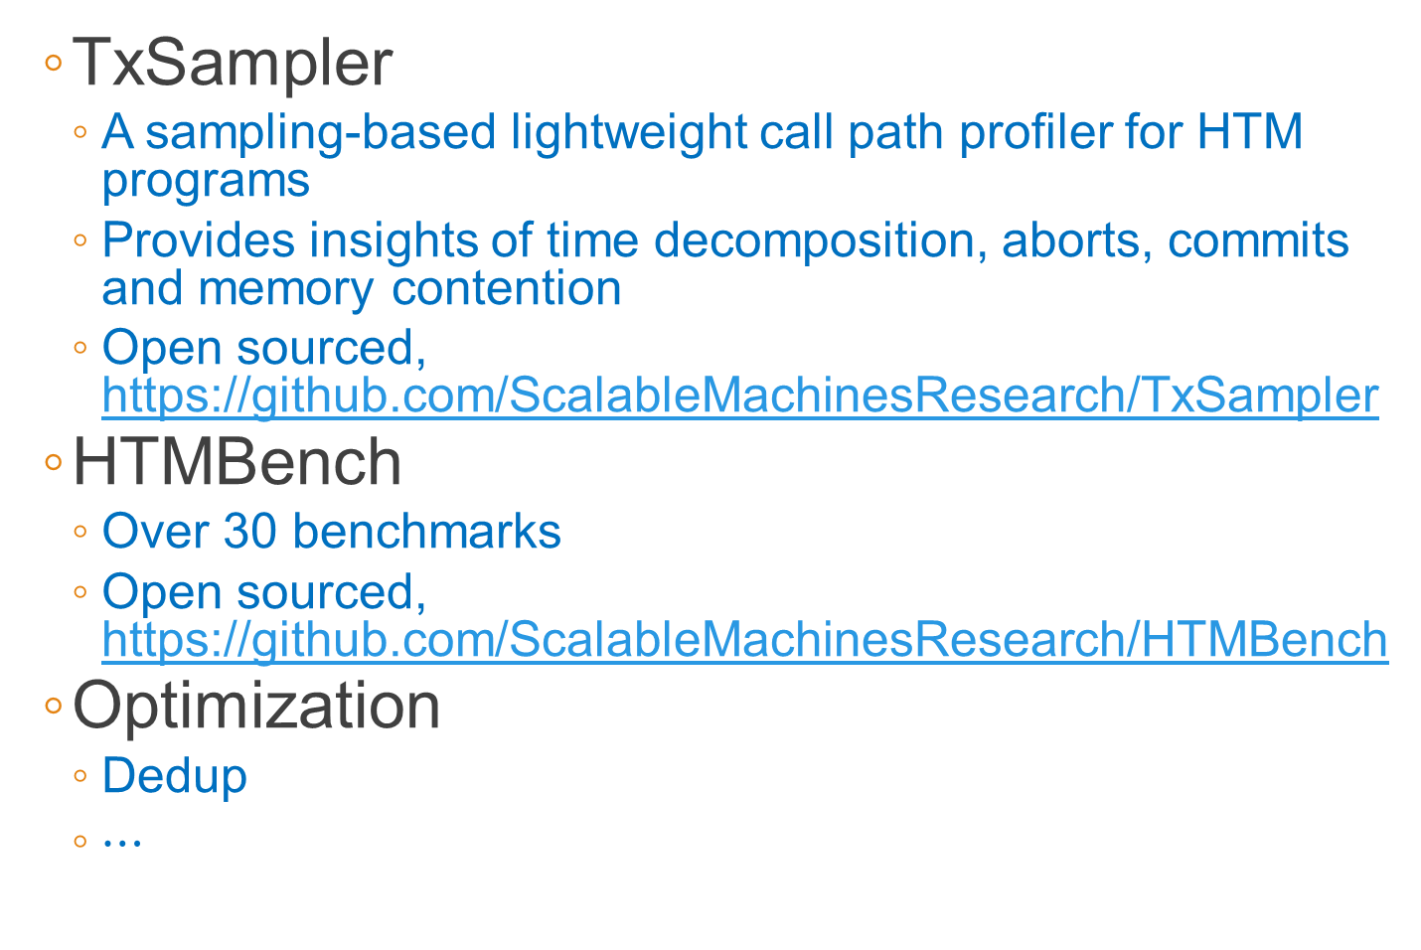
Conclusion
TxSampler
A sampling-based lightweight call path profiler for HTM programs
Provides insights of time decomposition, aborts, commits and memory contention
Open sourced, https://github.com/ScalableMachinesResearch/TxSampler
HTMBench
Over 30 benchmarks
Open sourced, https://github.com/ScalableMachinesResearch/HTMBench
Optimization
Dedup
$⋯$
Questions?

